Slide 1
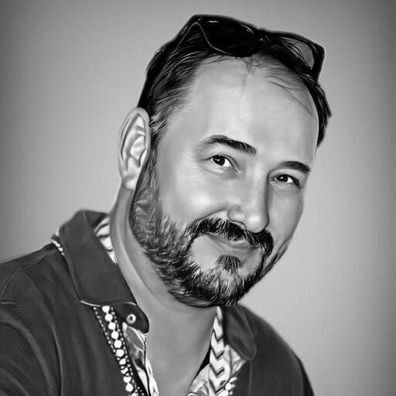
Ask Anthony: Chat with your AI Bootcamp Instructor!
Derek Rikkie, Rodney Simba Masarirambi, and Clayton M. Graves

Slide 2
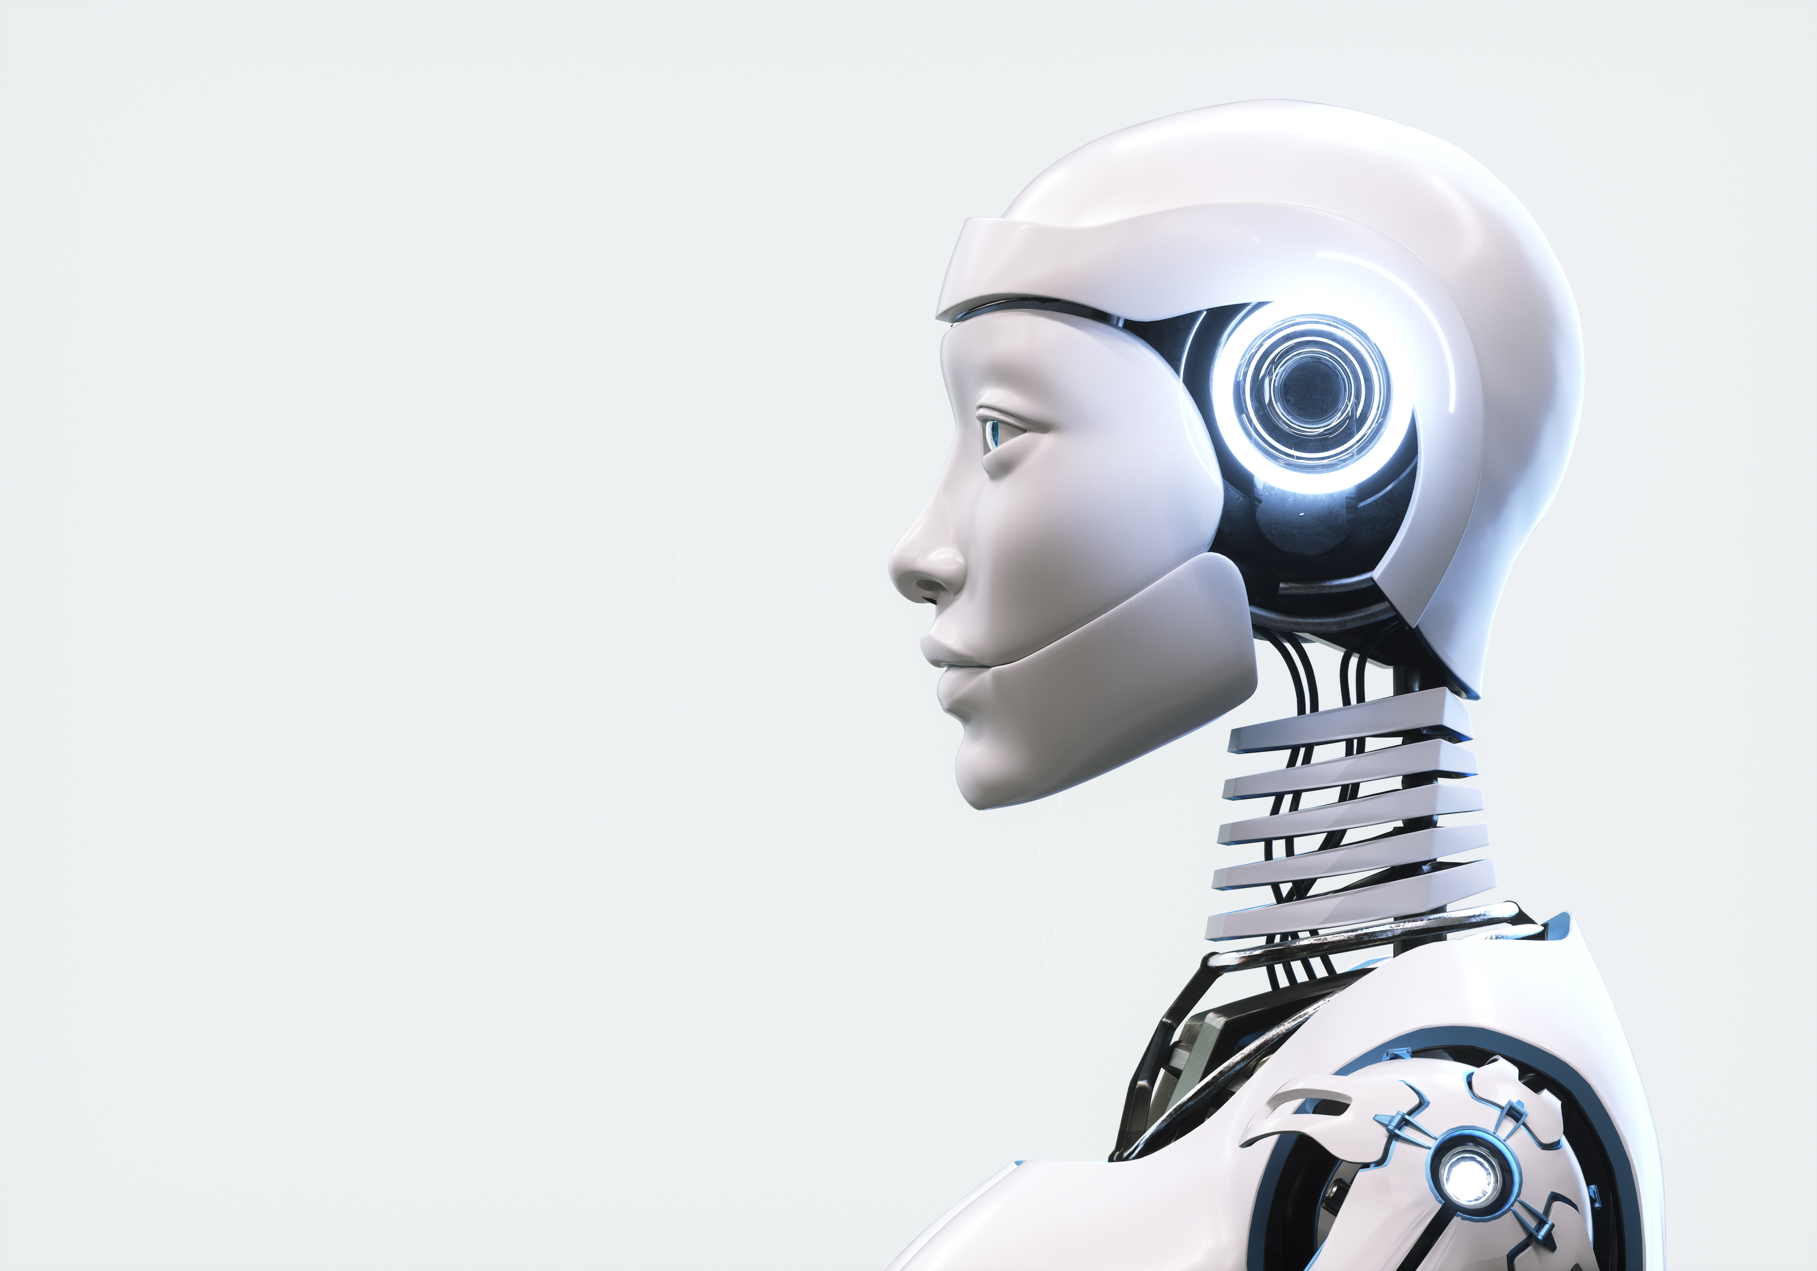

Agenda
Introduction​
Our Team
Primary goals​
Data Processing
Model Implementation
Model Optimization
User Interface
Plan For Future Development
Summary​

Slide 3
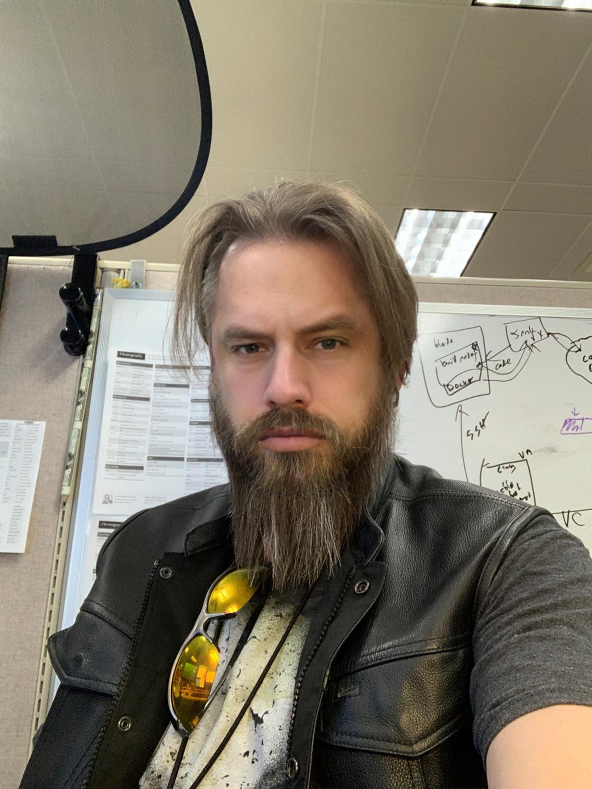
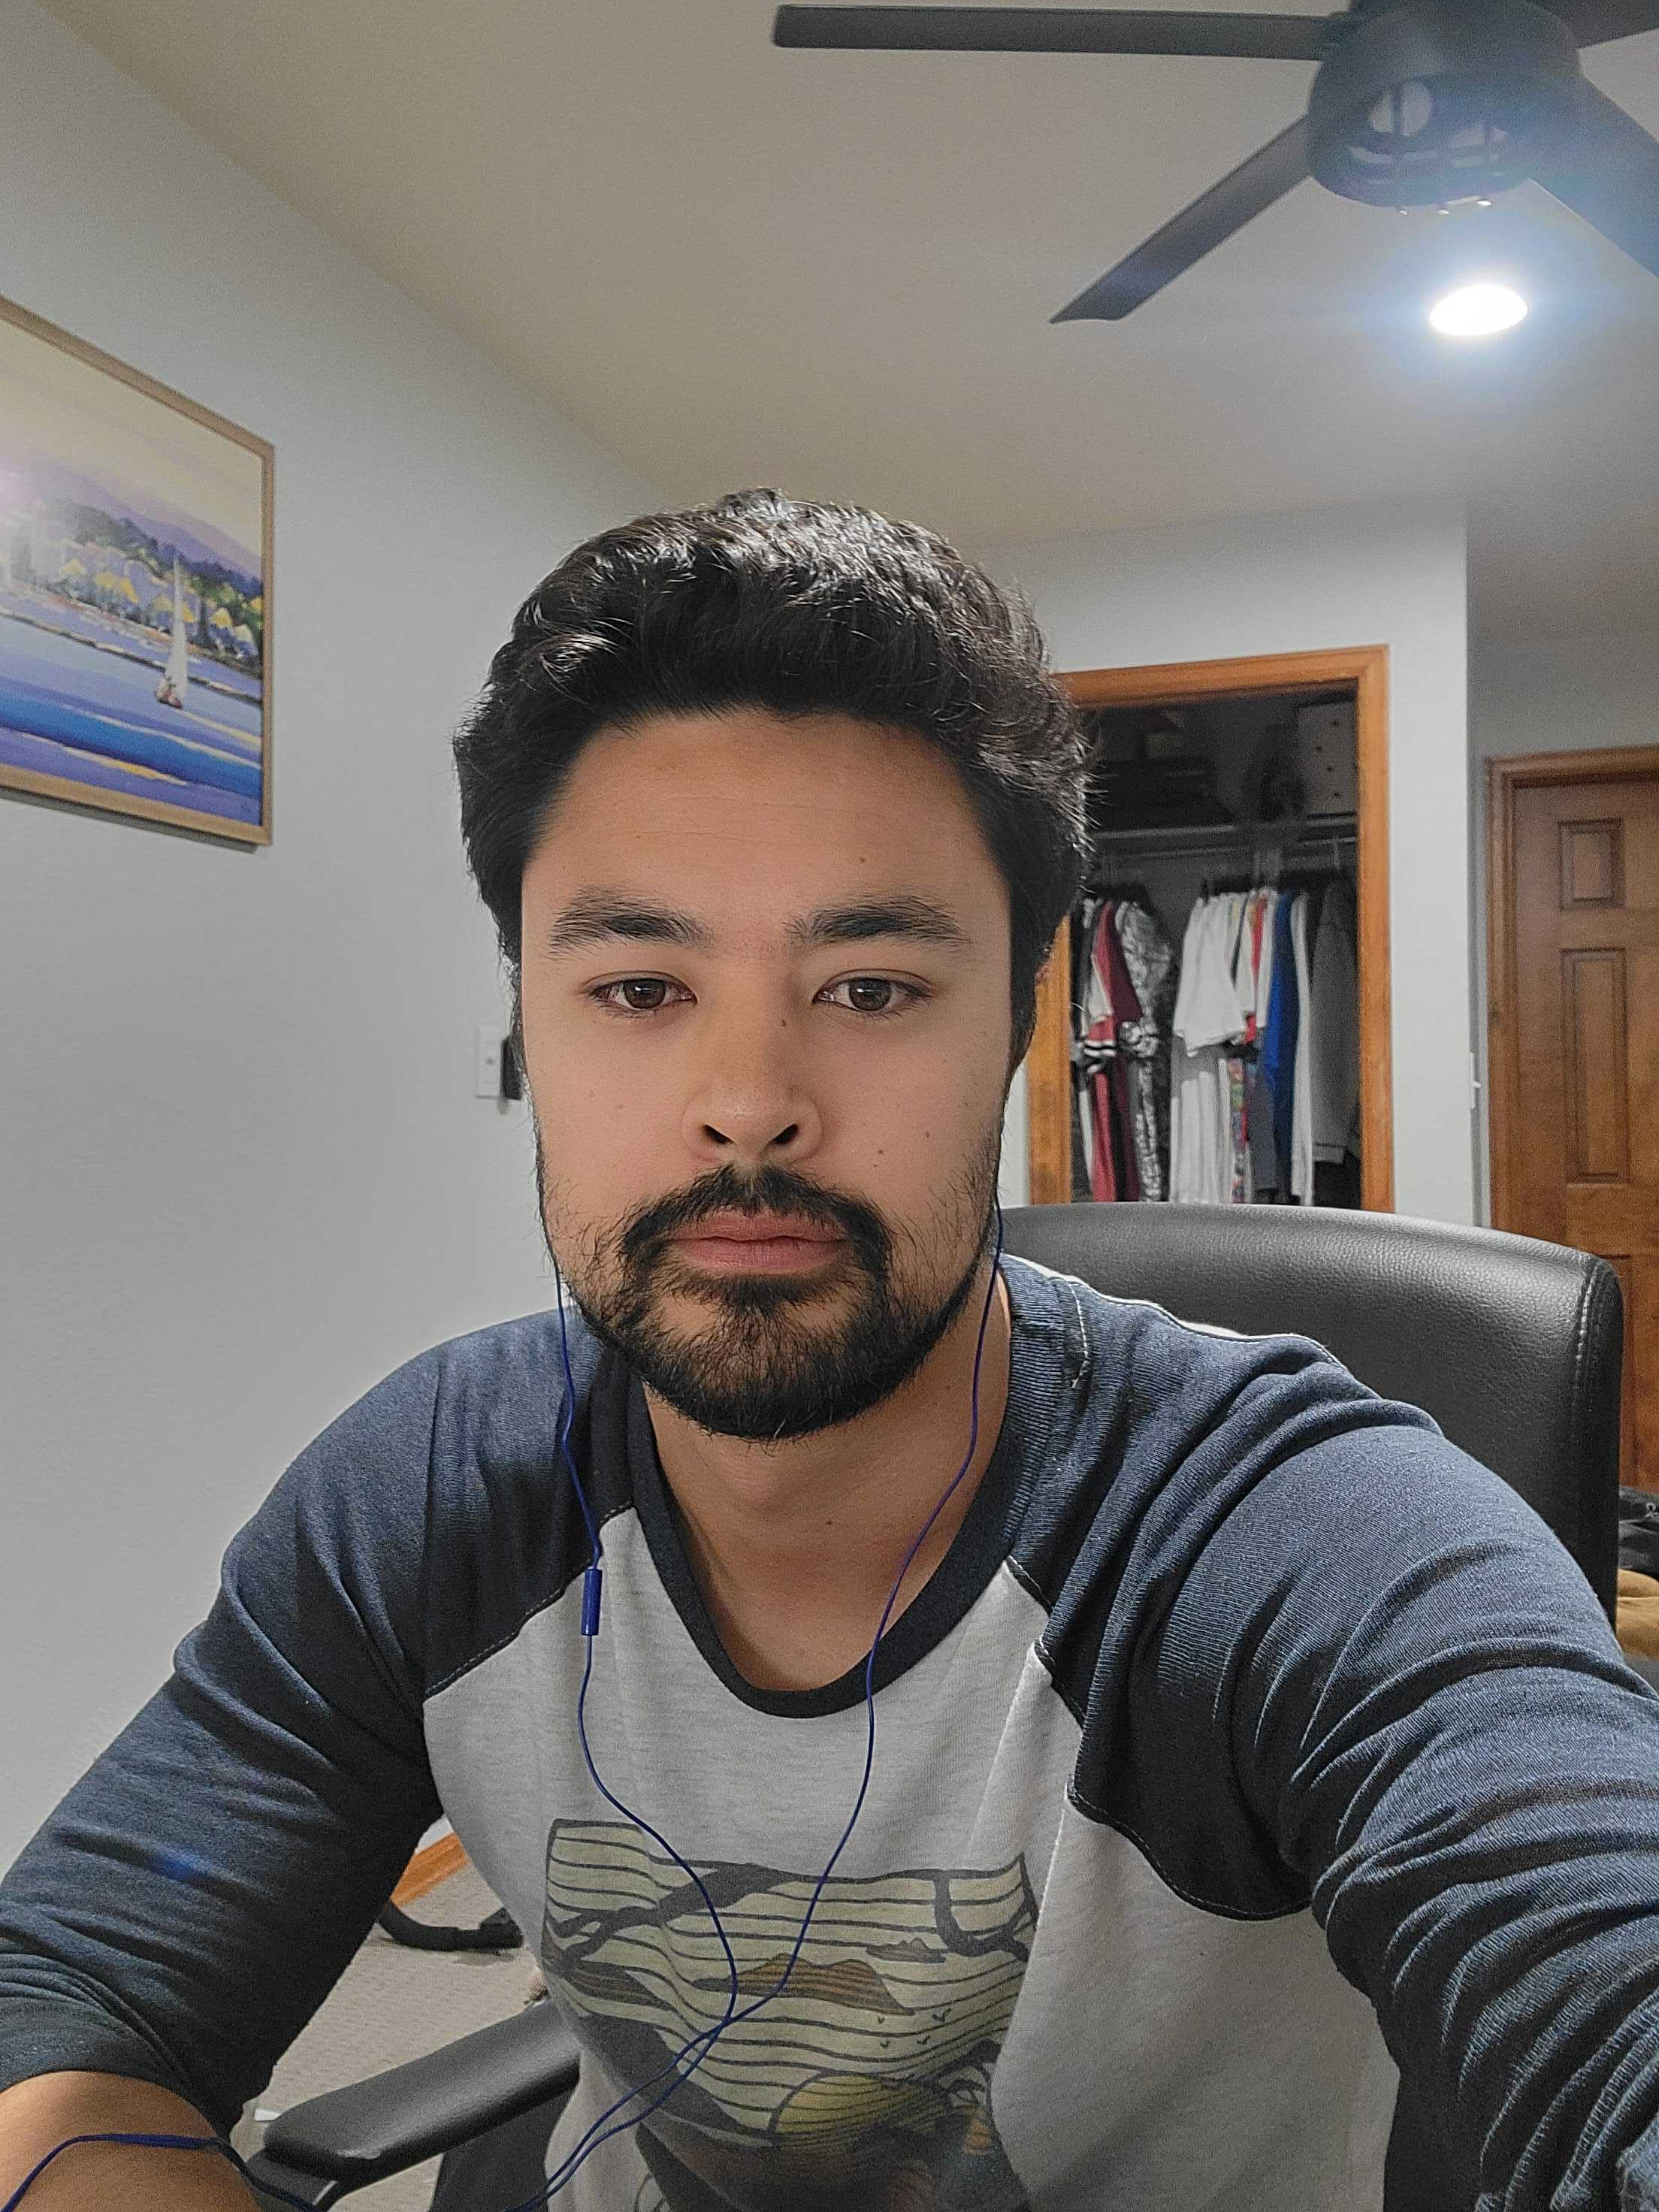
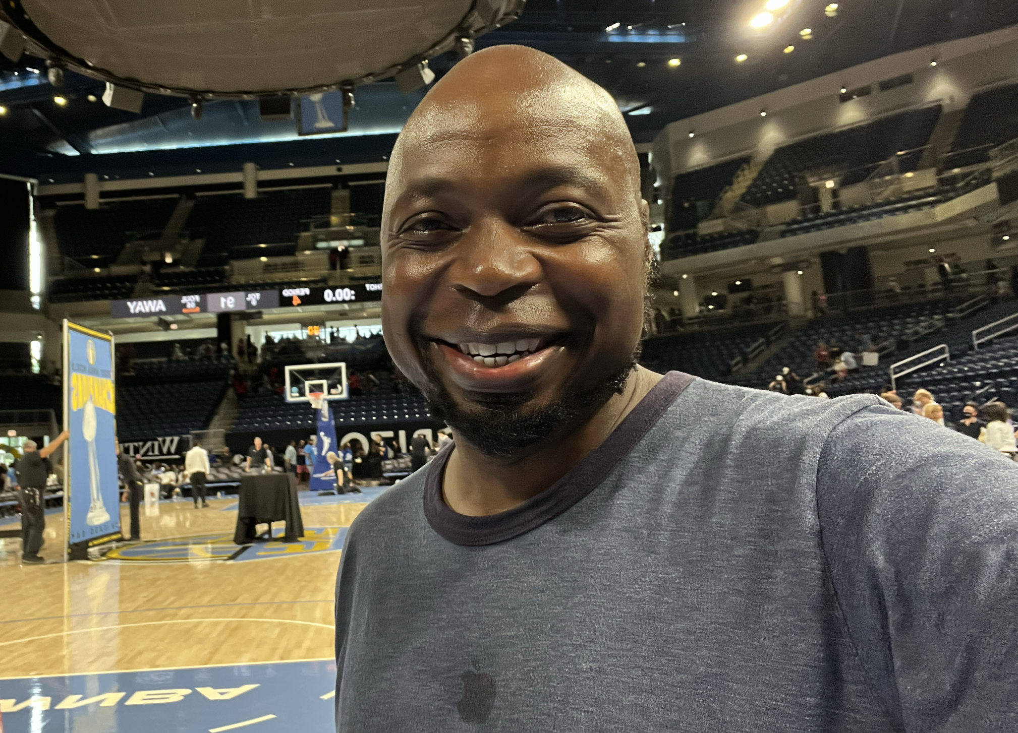
Our Team
Clayton Graves​​
Derek Rikke
Data Processing and Presentation
Model Implementation and Optimization
Rodney Simba Masarirambi
Anthony Taylor​
User Interface
Instructor and Inspiration​

Slide 4

Introduction
Our Last Hurrah: Leaving a Legacy!
For our final project, we're aiming big: to leave a lasting impact on the class and secure our place in data science history. We're crafting something special that'll keep the knowledge flowing long after we've moved on. And guess what? We're taking Anthony with us! Let's make this journey one for the books!

Slide 5
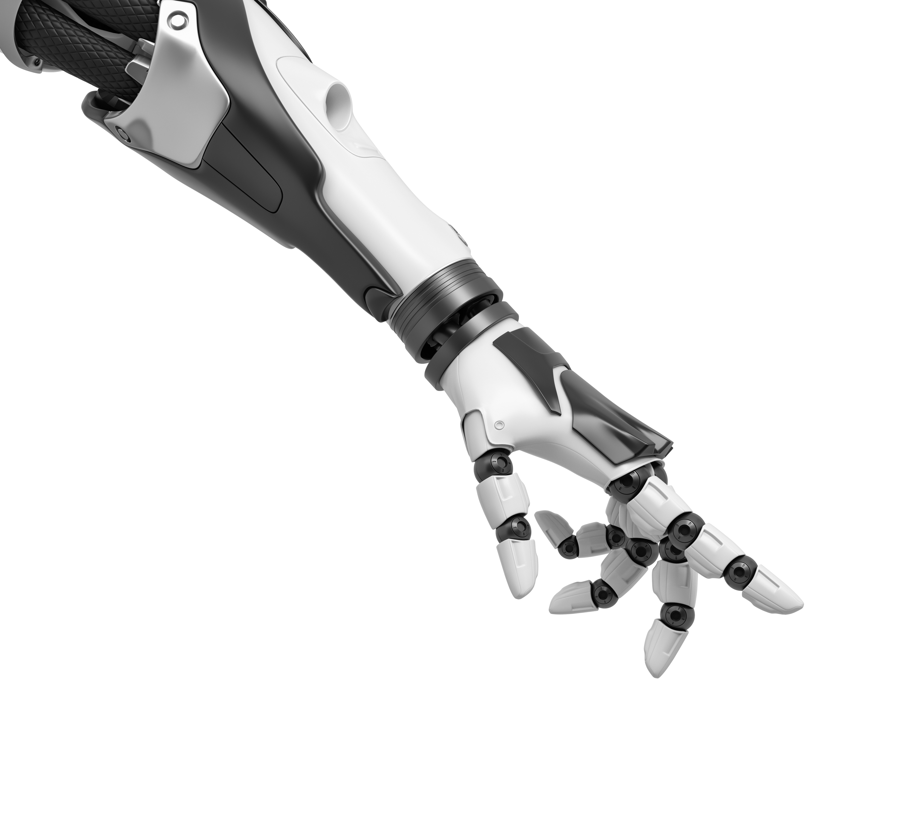
Primary Goals
Brains Behind the Bot:
Craft a chatbot that’s not just any chatbot – Its your own virtual TA!
The Knowledge Nexus:
Equip our model with the full arsenal: class codes, slide decks, and lecture transcripts. It’s the ultimate knowledge hub at your fingertips!
Guidance Guru:
Need more info? No problem! Our model’s got your back, guiding you straight to the juiciest lesson tidbits and notes for deeper dives.
Sleek and Snazzy:
Say goodbye to clunky interfaces! We’re designing a sleek, intuitive and easy to use interface.
File Finding Magic:
Easily locate specific class files based on their content – no more digging through folders!
Anthony Vibes Only:
Every response is laced with Anthony’s signature style and humor, so you feel like he's right there in the room with you – no boring bots allowed!

Slide 6

Data Processing
Exercise Integration: Our endeavor involved pulling all exercises and their corresponding code into the model's extensive repository. We meticulously converted them into text format, distinguishing between markdown and code components using our specialized delimiter.
Slide Transformation: We systematically converted all slides into PDF format using the fitz framework and seamlessly integrated them into the model. This streamlined process ensures efficient handling of presentation materials, enhancing accessibility and usability.
Transcript Processing: We embarked on the task of converting transcripts into text format. However, our endeavors extended beyond mere conversion. We meticulously curated specific examples exemplifying Anthony's distinctive style to train our model. This approach ensures the infusion of his wit, charm, and unparalleled expertise into our system.

Slide 7
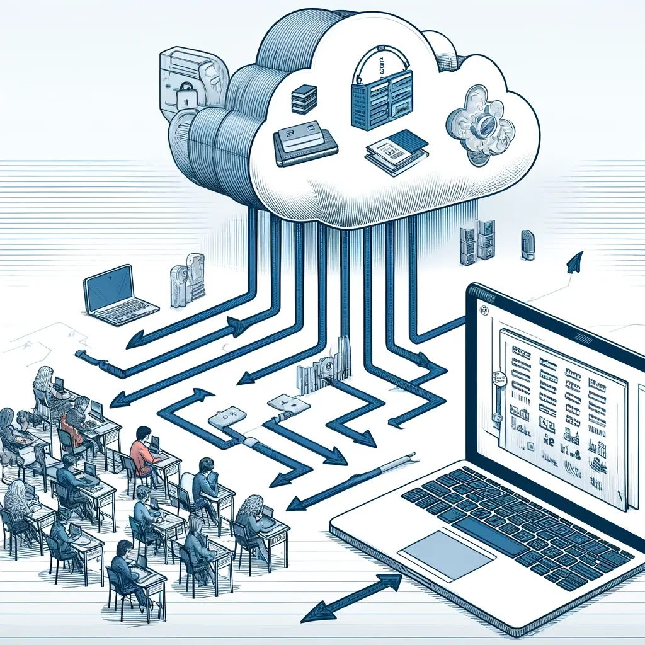
Model Implementation
Two model architecture: ConversationalRetrievalChain --> ChatChain
ChatGPT 3.5-Turbo
Cloud vector storage using Qdrant
creating a cluster and collection on Qdrant
load pdf and txt files using OpenAi's embeddings, length 1536
CRC answers questions based on source documents
Search Qdrant collection for most relevant document
Combine source document and CRC response, feed it into 'Flair' bot
Flair bot uses few shot prompting to add personality to the response while maintaining the answer integrity and correct point of view
Write final response to the user, including source document, answer, and flair

Slide 8

Model Optimization
Modify source data
Maintain separate files for source document search
Improve accuracy of file names for better source document search
Prefix prompt engineering
Maintain correct point of view, "Great question!" vs "Great insight!“
Adjust levels of personality traits, ensure variety.
Example prompt engineering
Example variety and number

Slide 9

User Interface
Our application runs on a streamlined user interface called Streamlit.
A simple yet effective text input mechanism handles user queries with high efficiency and supports immediate query processing and response generation.
The chat history is managed within a sidebar, maintaining an uncluttered main interaction space while providing easy access to previous conversations.
Through these mechanisms, the “Ask Anthony” chatbot significantly enriches the learning environment, making educational content more accessible and interactive for bootcamp students.

Slide 10
Plan For Future Development
DATA
Model
Response
User Interface
Launch
Refine user interface so that it is browser agnostic
Generate empty text-box after answer generation
Refining subjects
Better grouping
Merging transcripts, code, and slides into one file for each subject
Nail down chat history
App structure and organization
Fine-tune open-source model
Gather better response examples
Improve response model so that it tailors itself to the question
Web Hosting
Making sure the date we use is not proprietary

Slide 11

Summary
Through this project we gained an overwhelming amount of experience four unexpected areas.
Preprocessing data for a very specific task
Using new libraries by reading documentation
PROMPT ENGINEERING
UI creation\
And now, time for a live demo

Slide 12
By the Way…
The site is live…
https://askanthony.streamlit.app/
Or, you can download it yourself at:
https://github.com/lordegraves/final_project_bootcamp.git

